Slide 1
BAY AREA PROPERTY SERVICES: INTRODUCING THE FUTURE OF ONLINE HOA BILL PAY & BANKING

Slide 2
HOW HOAs CAN MAXIMIZE AP EFFICIENCY WITH STRONGROOM

Slide 3
ABOUT STRONGROOM PAYABLES LOCKBOX
Strongroom was founded 11 years ago, and in 2015 was purchased by AvidXchange, Inc. (leader in AP Automation).
We are a Software as a Service (Saas) PLUS Outsourcing/Services
First Payables Lockbox customer was through Sterling Bancshares (Comerica) – 1/2007
Pioneer in Homeowner Association (HOA) vertical segment, with 400+ HOA Management Companies, 40,000+ Active Users in over 43 states
SSAE 16 SOC 1 Type II Audit

Slide 4
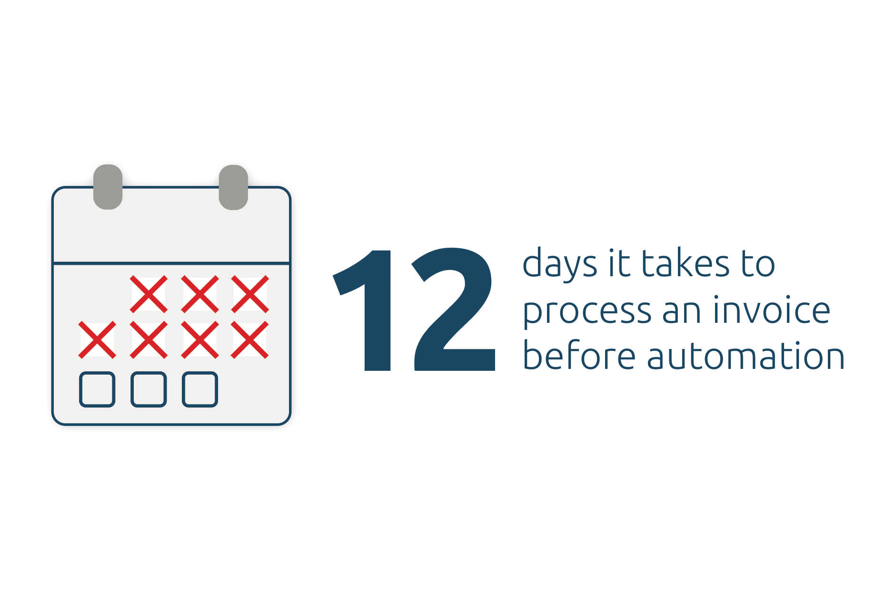
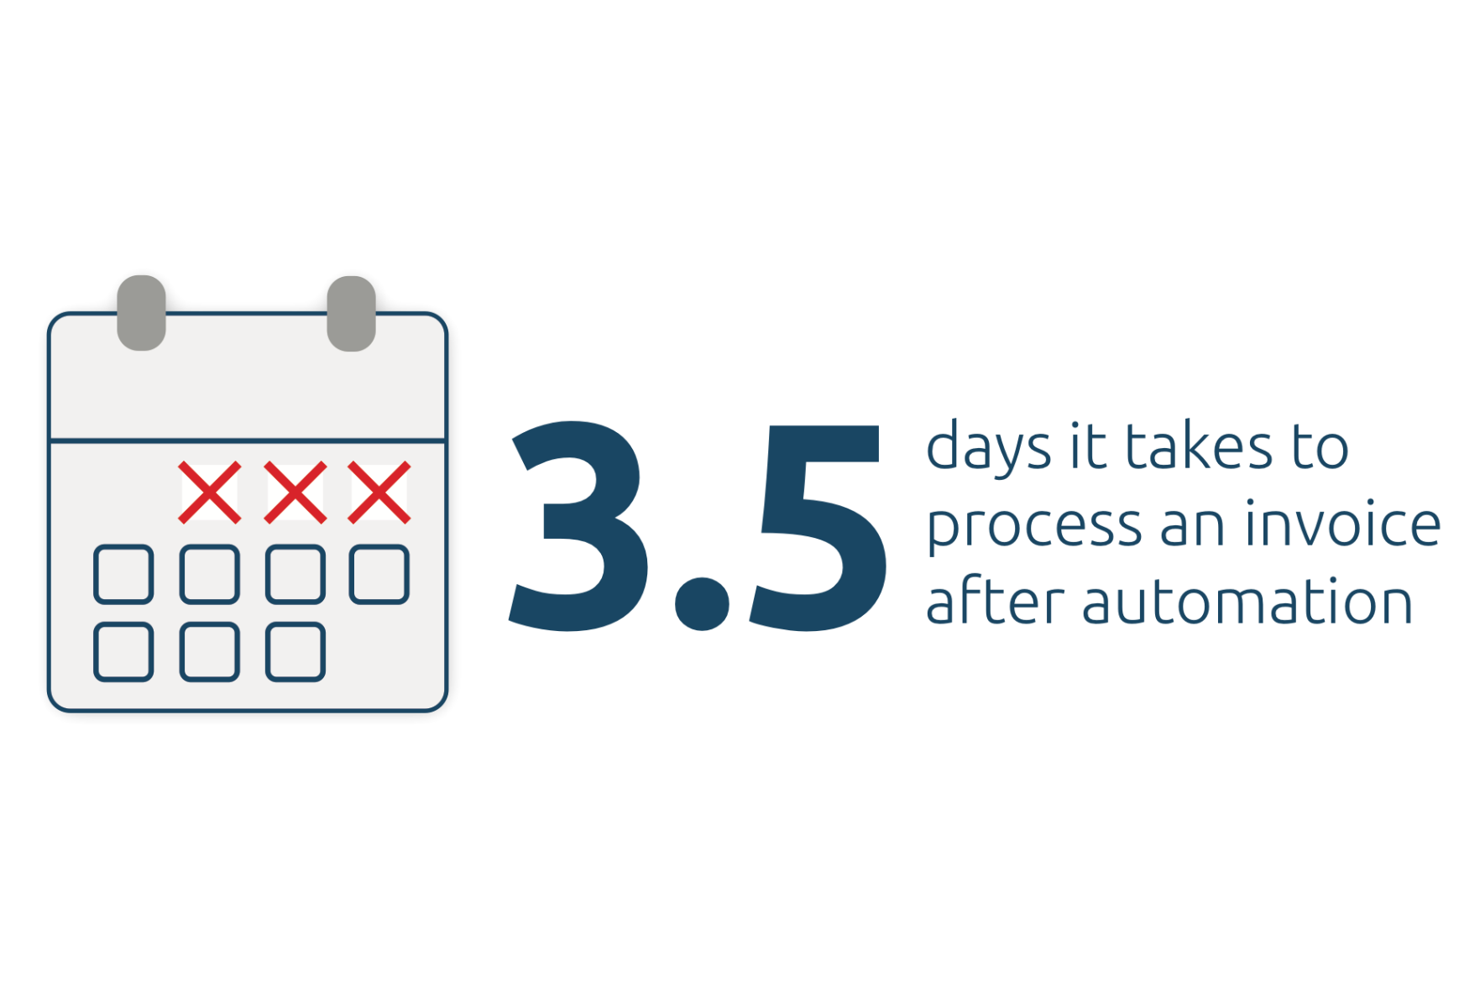
IMPACT OF STREAMLINING PAYABLES
Make Smarter Decisions!
Drive your organization to financial success!

Slide 5
STRONGROOM PROCESS
Strongroom
Strongroom Sync
1st Approval
2nd Approval
3rd Approval

Slide 6
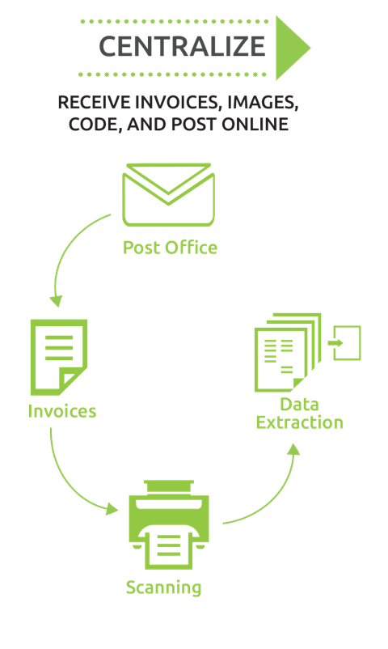
INVOICES RECEIVED BY STRONGROOM
BAPS will have their own email and postal address for invoices
Vendors can send invoices directly to Strongroom
Invoices received today will be processed the same day and our data entry team will enter in all of the header data overnight.
The invoice image and data will be in the 1st approver’s queue for the appropriate property the following morning.

Slide 7
INVOICE APPROVALS
Users are notified via a daily email when they have invoices in their queue for approval.
When logging in, users see their list of invoices and upon clicking on one, will see the invoice image and the data/notes about the invoice.
Users can approve the invoice to move it to the next approver in the workflow, or if they do not approve the invoice, they can reject it back to a previous step (determined by BAPS).
Users can always go back and view invoices they have approved or rejected.

Slide 8
INVOICE PAYMENTS
**Once all approvals are met on an invoice, the payment will be made.
Vendors can choose if they want to be paid electronically (ACH or Virtual Card) or by check payment.
Full visibility is available for board members to search for and view invoices and payments and export reports via Strongroom.
** Invoices default to be paid on final approval, but BAPS will have the option of scheduling a pay date to a future date. It will still only be paid if the required approvals are met.

Slide 9
What will my experience be like?

Slide 10
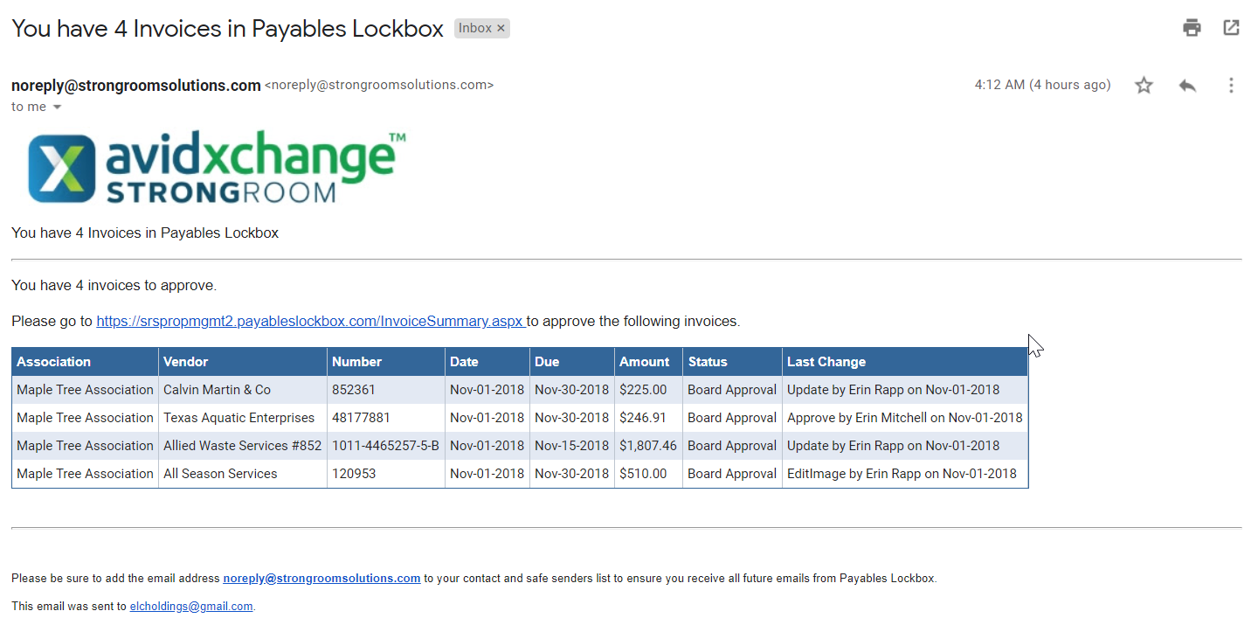
You’ve Got Mail

Slide 11
Logging into Strongroom

Slide 12
What Do I Need To Work On Today?

Slide 13
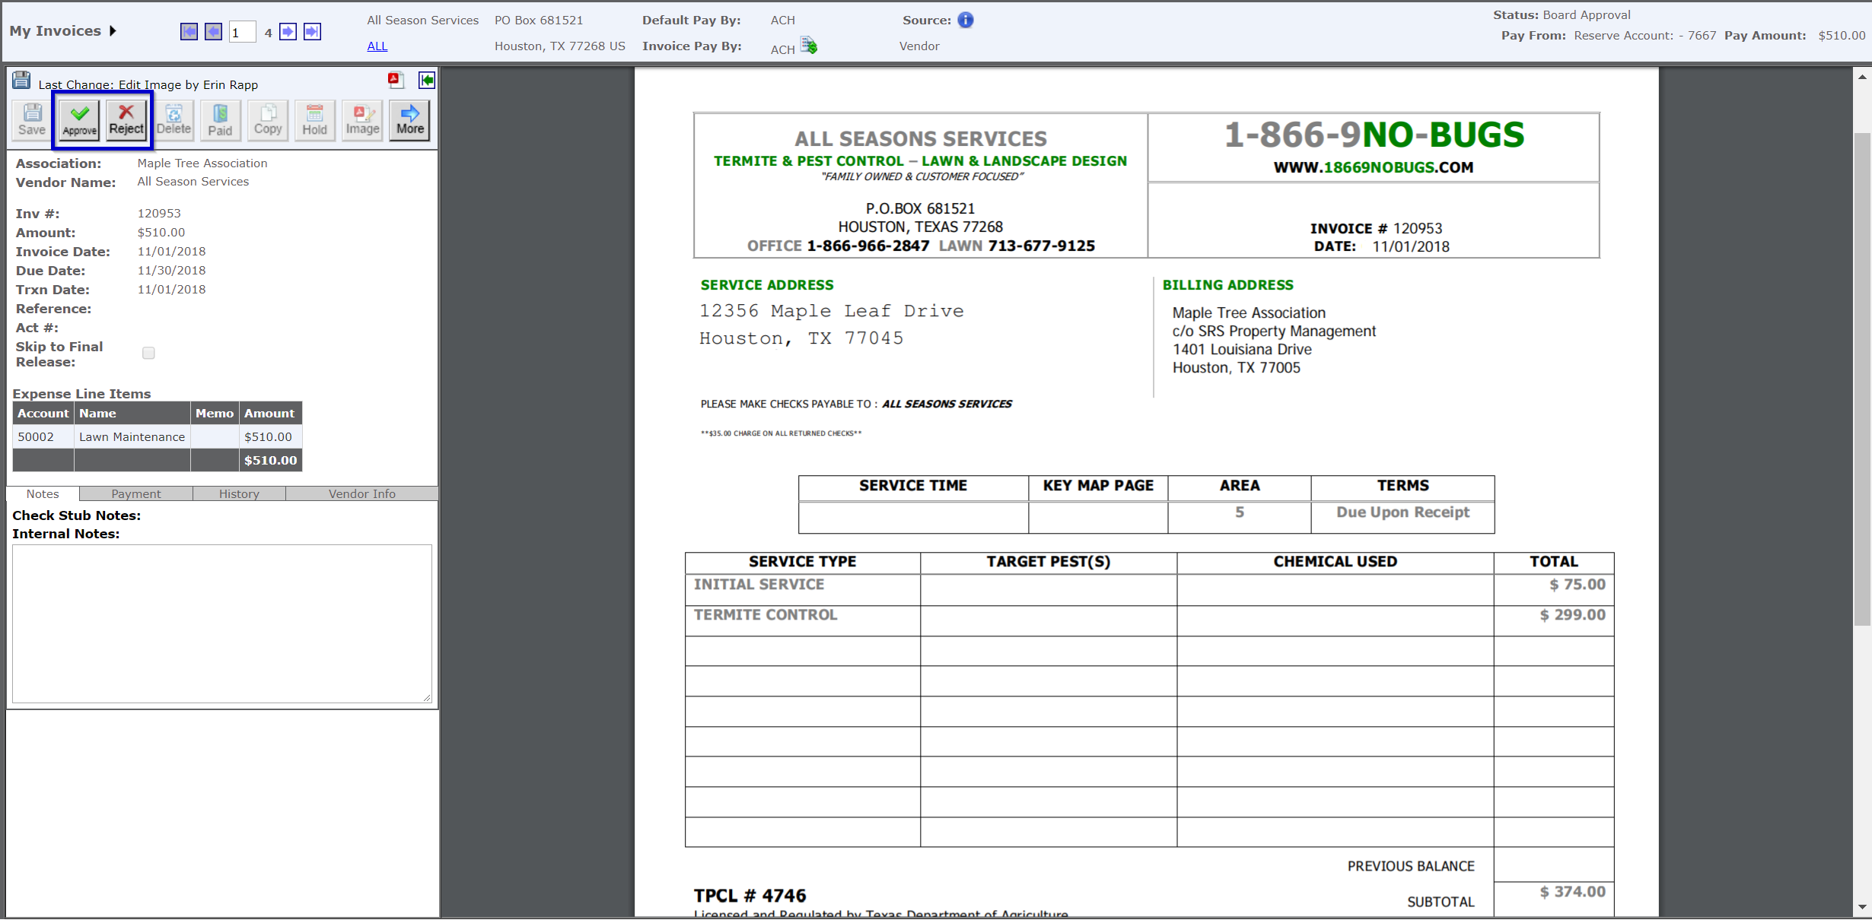
View the invoices in your queue

Slide 14
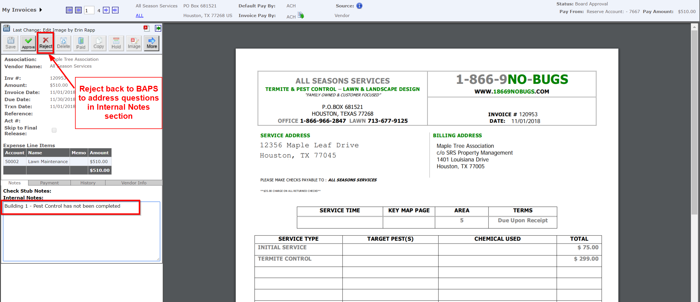
Communicate with Ease Regarding Any Questions Before Approving

Slide 15
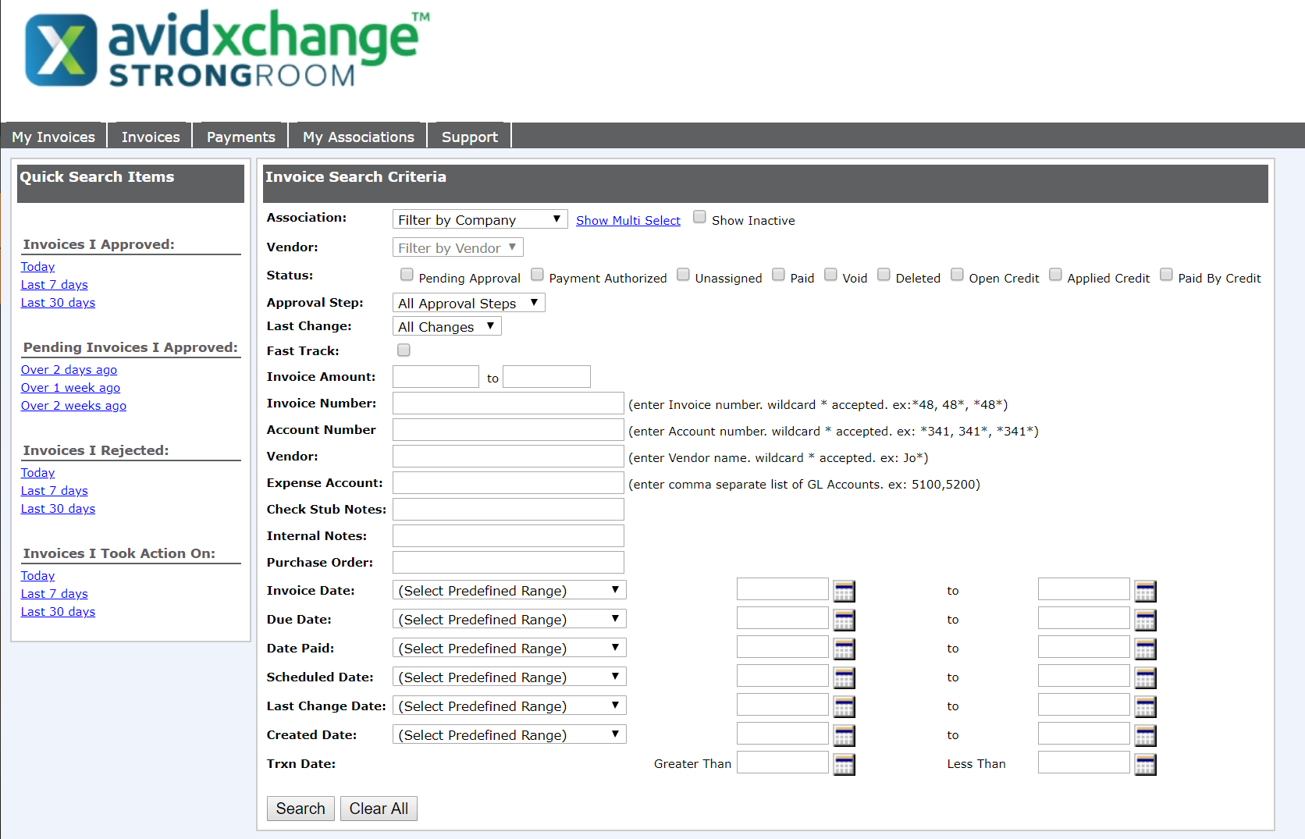
Make Audits & Research Projects Easy

Slide 16
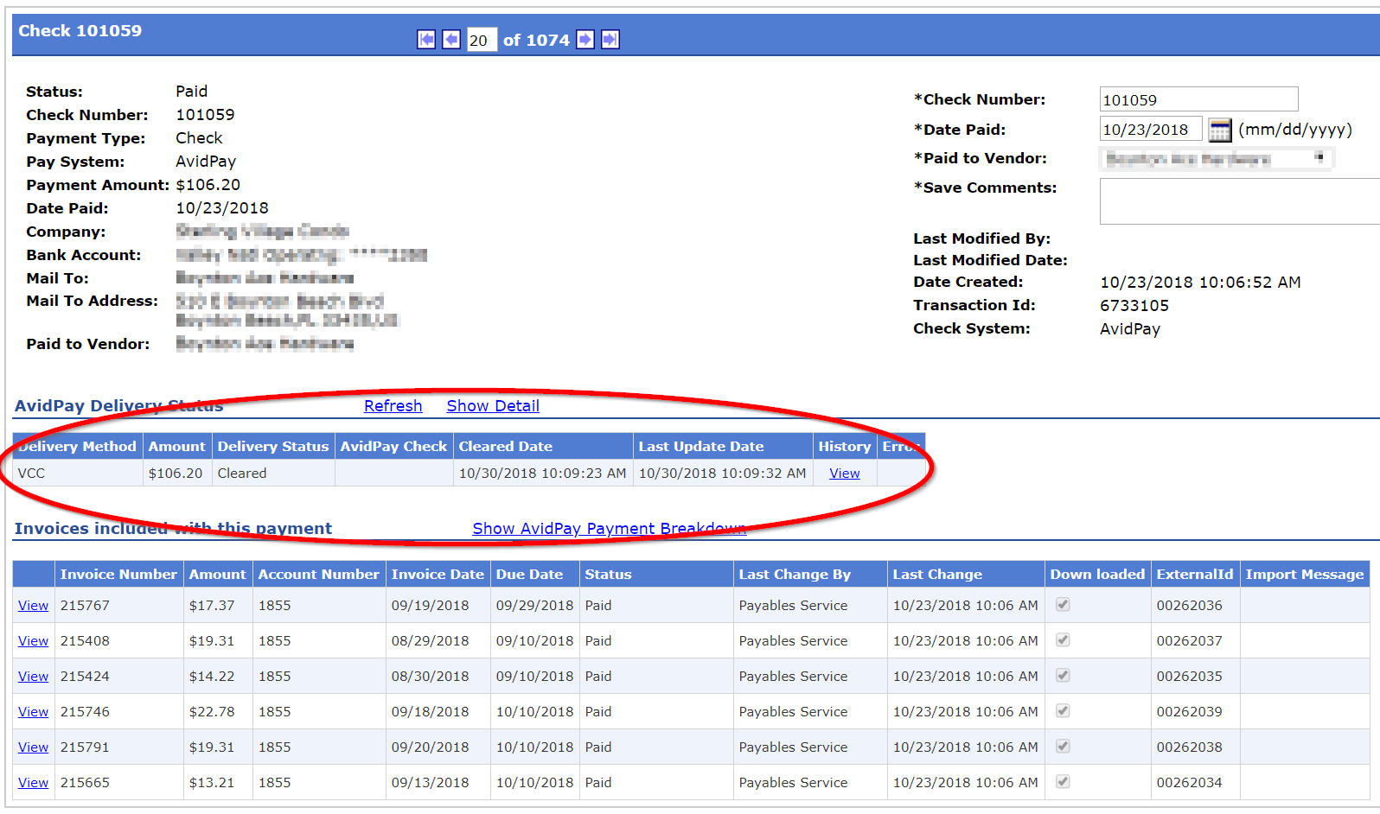
Research Payment Status & Approval

Slide 17
Security & Confidentiality

Slide 18
Security FAQs:
Each user has their own user profile, username and password that they set when they first register.
Each user will be assigned to specific role(s) and to their assigned property/properties. Users only see items related to their specific property/properties.
There is a complete audit history on each invoice which shows every action (Update, Approve, Reject, etc) that has occurred on the invoice since it’s inception into Strongroom (with the name of the user and a date/time stamp).
BAPS has the option of setting up Multi-Factor Authentication for login verifications (2, 3, and 4 way) as well as Data Access verifications (SMS).

